Slide 1

G H RAISONI COLLEGE OF ENGINEERING & MANAGEMENT WAGHOLI, PUNE – 412 207
(An Autonomous Institute Affiliated to SPPU)
TAE2: Powerpoint Presentation
Modeling of Digital Circuit-UECL106
Multiplexers and Demultiplexers
Roll No | Student Name
A69 | Soham Yugraj Tiwari
A70 | Amaan Ayyub Nalband
A71 | Shravan Vijaypratap Singh
A72 | Pratik Rajesh Jade
Presented to: Ms.Shubhangi Lohakpure

Slide 2
Multiplexers
Multiplexer is a special type of combinational circuit. A data selector, more commonly called a Multiplexer, shortened to "Mux" or "MPX", are combinational logic switching devices that operate like a very fast acting multiple position rotary switch.
They connect or control, multiple input lines called "channels" consisting of either 2, 4, 8 or 16 individual inputs, one at a time to an output.
There are n-data inputs, one output and m select inputs with 2m = n. It is a digital circuit which selects one of the n data inputs and routes it to the output.
Then the job of a "multiplexer" is to allow multiple signals to share a single common output.
For example, a single 8-channel multiplexer would connect one of its eight inputs to the single data output.
Multiplexers are used as one method of reducing the number of logic gates required in a circuit or when a single data line is required to carry two or more different digital signals.
The selection of one of the n inputs is done by the selected inputs. Depending on the digital code applied at the selected inputs, one out of n data sources is selected and transmitted to the single output Y.
E is called the strobe or enable input which is useful for the cascading. It is generally an active low terminal, that means it will perform the required operation when it is low.

Slide 3
Multiplexers comes in Multiple Variations
2:1
MUX
2:1 Multiplexer
4:1 Multiplexer
8:1 Multiplexer
16:1 Multiplexer
32:1 Multiplexer
D0
D1
Y
E
Enable | Select | Output
E | S | Y
0 | X | 0
1 | 0 | D0
1 | 1 | D1
Block Diagram

Slide 4
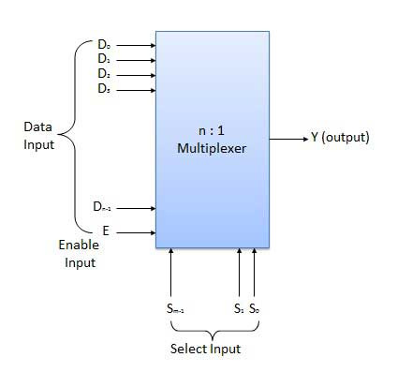
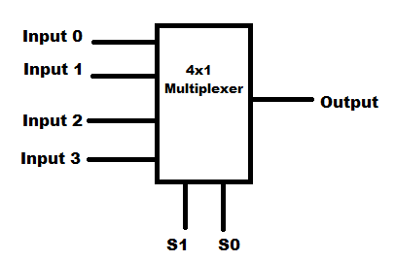
n:1 Multiplexer
4:1 Multiplexer

Slide 5
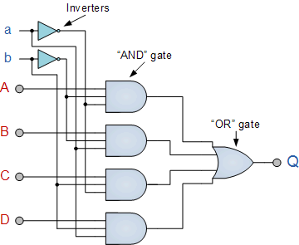
4 Channel Multiplexer using Logic Gates

Slide 6
Demultiplexers
A demultiplexer performs the reverse operation of a multiplexer i.e. it receives one input and distributes it over several outputs.
It has only one input, n outputs, m select input. At a time only one output line is selected by the select lines and the input is transmitted to the selected output line.
The demultiplexer takes one single input data line and then switches it to any one of a number of individual output lines one at a time.
The demultiplexer converts a serial data signal at the input to a parallel data at its output lines as shown below.
A de-multiplexer is equivalent to a single pole multiple way switch.

Slide 7
Demultiplexers
Demultiplexers comes in multiple variations
1:2 Demultiplexer
1:4 Demultiplexer
1:8 Demultiplexer
1:16 Demultiplexer
1:32 Demultiplexer
Unlike multiplexers which convert data from a single data line to multiple lines and demultiplexers which convert multiple lines to a single data line.
Din
1:2
DEMUX
Enable | Select | Output
E | S | Y0 Y1
0 | x | 0 0
1 | 0 | 0 Din
1 | 1 | Din 0
Y0
Y1
E
Block Diagram

Slide 8
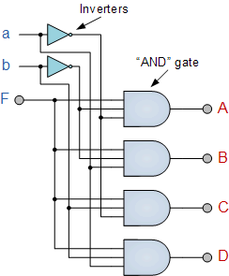
4 Channel Demultiplexer using Logic Gates.
Thank
You…

